Slide 1
Arup Advanced Technology and Research (AT+R)
Shinya Kondo
Notes:
Thank you for giving me the opportunity to present today. In this presentation, I'll briefly introduce myself and highlight two projects I've worked on as a CFD researcher and discuss why I'd be a good fit to become a member of the AT+R team.

Slide 2

About me
Second year PhD candidate at the University of Pennsylvania
Main Research: Building blocks of fluid flows
Other General Interests
Reduced-order modeling of nonlinear dynamical systems
Numerical methods
Continuum mechanics
Notes:
I'd first like to start by quickly introducing myself. I am currently a second year PhD student studying mechanical engineering where my research is currently being funded by the NSF. My main research focus is in the most general way possible considering the building blocks of fluid flows by applying modal analysis techniques to extract the most coherent structures within a fluid flow.
My work naturally lean towards CF D, turbulence physics and fluid mechanics; however, I like to apply what I know to other fields such as reduced-order modeling of nonlinear dynamical systems, numerical methods and continuum mechanics.

Slide 3

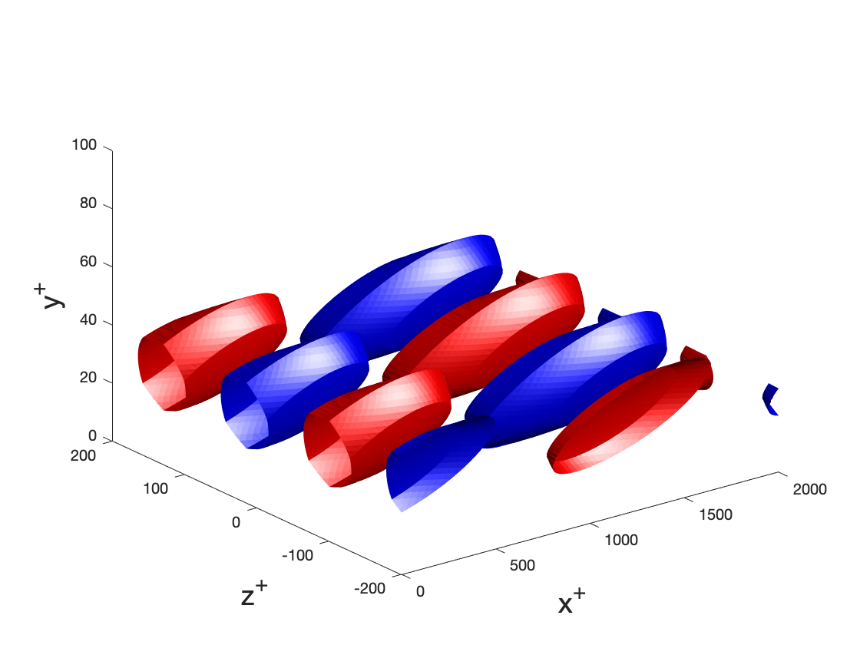
Projects
Project 1
Structural analysis of wind turbines in extreme wind conditions
Project 2
Reduced-order modeling of near wall turbulent structures
Notes:
Today, I'd like to discuss two projects I've worked on. One is more practical and is on the structural failure of wind turbines in extreme conditions while the other is slightly heavier in math and deals with reduced-order modeling of near-wall turbulent structures by developing the state space of non-linear dynamics using spectral manifolds.

Slide 4
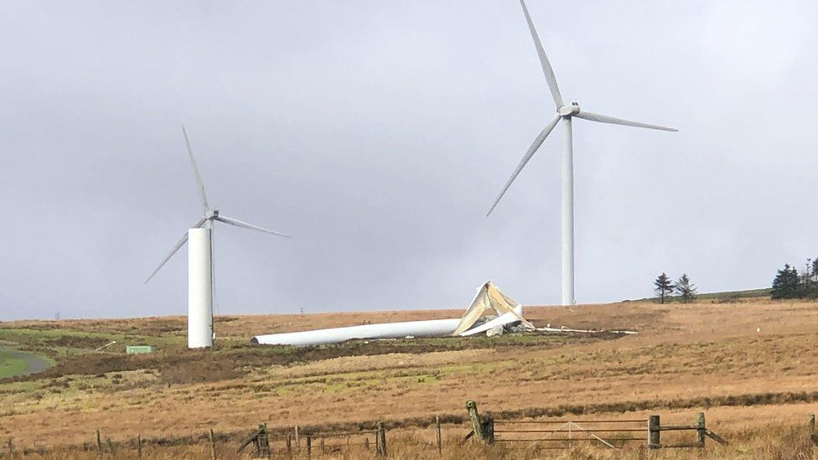
Project 1: Tower Failure of Wind Turbines in Extreme Wind Conditions
Tropical cyclones and strong winds can induce structural failures in wind turbines
Objective: How can we numerically simulate the structural response of wind turbines during extreme wind conditions
Figure: Wind turbines in a “feathered” states buckling due to extreme wind conditions
Image source: BBC
Notes:
The change in global temperature has resulted in more frequency extreme weather events. As the number of tropical storms and strong winds increase, it becomes increasingly important to build structures that are resilient to these global effects.
Wind turbines are extremely suseptible to structural failures since even when they are non-operational, they are in a stationary state, "feathered" state, which may still induce a substantial thrust to induce failure in the base of the wind turbine as shown in the figure below.
Thus, the objective of this project was to numerically simulate the failure of wind turbines during extreme wind conditions
https://www.bbc.com/news/uk-wales-60390094

Slide 5
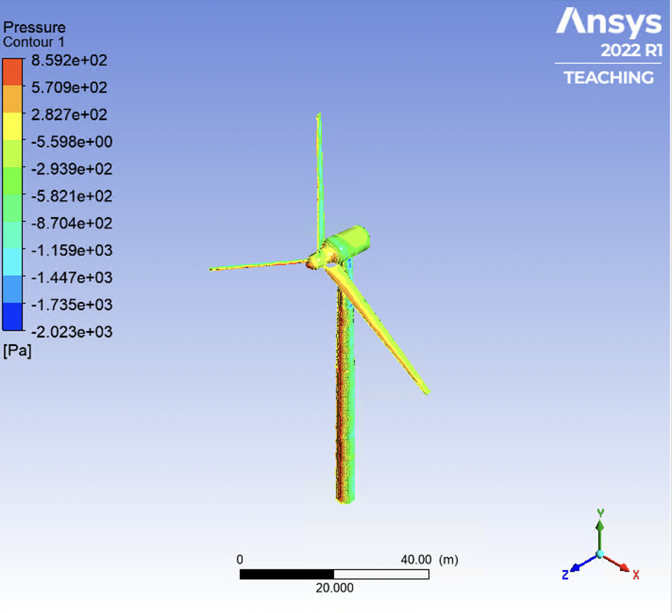
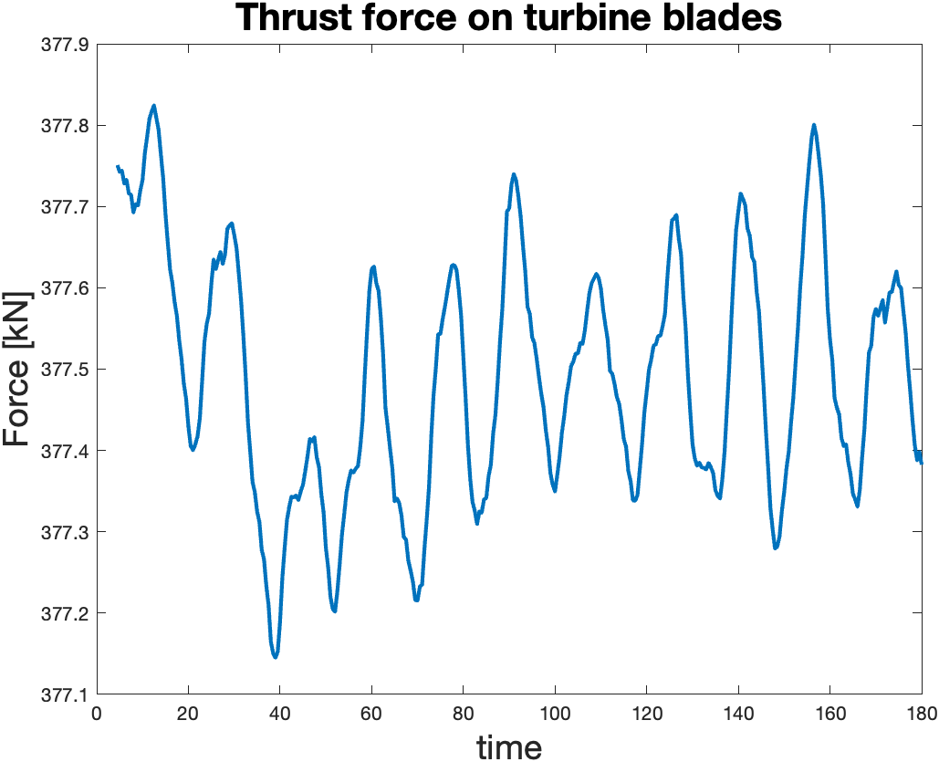
CFD simulation (ANSYS Fluent)
Tropical storm winds
50 m/s
16% turbulence intensity
RANS simulation w/ k-epsilon closure model
Numerical Scheme
2nd order spatial scheme
2nd order implicit time integration
Figure:
Color contour of pressure on wind turbine
Figure:
Time varying thrust force on turbine blades
Notes:
First, we computed the external load on the wind turbine structure by simulating the flow around wind turbine during typical cyclone conditions (50m/s winds with 16% turbulence intensity). I ran a RANS simulation with the k-epsilon turbulence closure model in ANSYS Fluent where I used second-order finite-difference scheme for the spatial values and a second-order implicit scheme for the time integration.
The figure on the top right shows the instantaneous pressure contour on the wind turbine body and the figure on the bottom right shows the time-varying thrust force on the wind turbine blades and the nacelle.

Slide 6
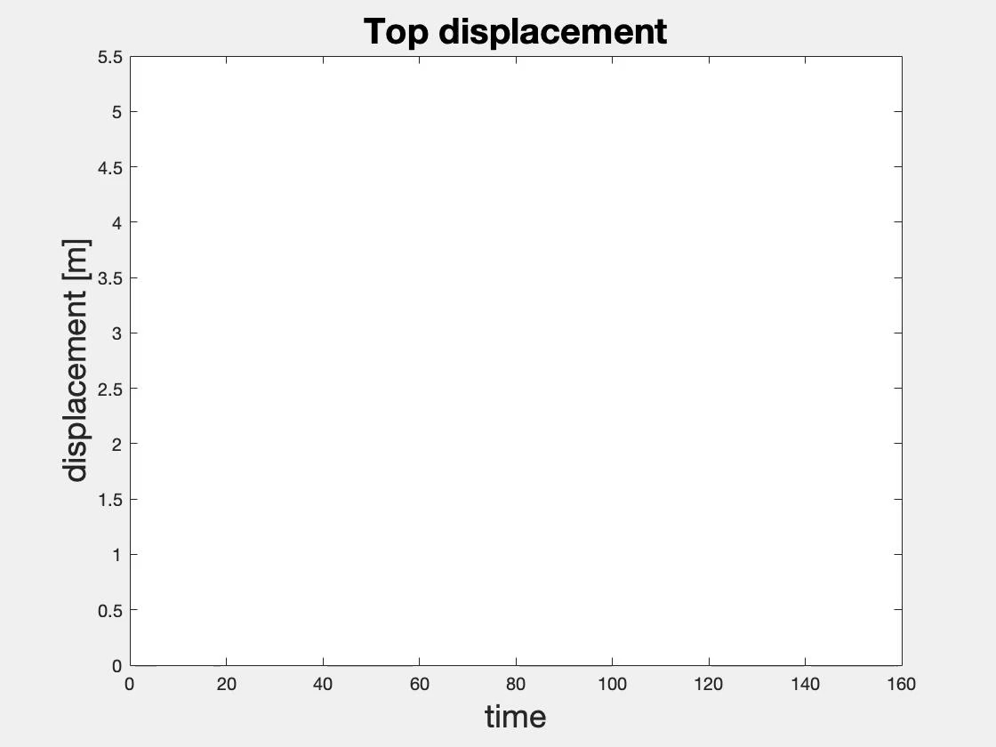

FEA simulation (ANSYS Mechanical)
Nonlinear structural analysis of wind turbine base (S335)
$$F_{thrust}$$
Figure: Von Mises Stress Contour
Notes:
Since the radial stress due to pressure is significantly smaller than the yield stress of the material used, I simplified the problem by applying the thrust force computed in the previous slide as a point load at the top of the base.
I conducted a nonlinear structural analysis of the wind turbine in ANSYS mechanical and used the commonly used Steele with yield stress 335 MPa as my material. By conducting a nonlinear analysis of this simplified model, we could compute how long it takes the structure to develop an initial plastic hinge and also where the plastic hinge is located.

Slide 7
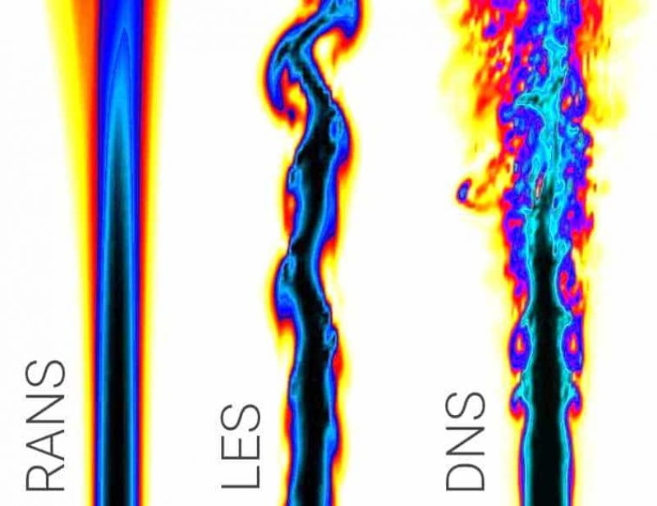
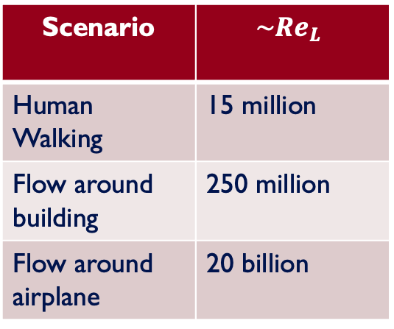


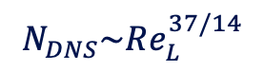
Project 2: ROM of near wall turbulence
Full-scale resolution of flows is computational expensive
Scenario | $$\sim Re_{L}$$
Human Walking | 15 million
Flow around building | 250 million
Flow around airplane | 20 billion
$$N_{RANS}\sim Re_{L}^{ 1/2}$$
$$N_{LES}\sim Re_{L}^{ }$$
$$N_{DNS}\sim Re_{L}^{37/14}$$
Bose & Park Annu. Rev. Fluid Mech., 2018
Notes:
The second project I've worked on is more related to my PhD thesis, which is on reduced-order modeling of near-wall turbulent structures.
To give a brief overview of the problem, there are currently three main classifications of CFD simulations. The simplest method is called the Reynolds averaged Navier Stokes and computes only the mean quantities while modeling all the fluctuating quantities. It is the least computationally expensive method and the grid-point requirement for an accurate solution is proportional the the square root of the streamwise length Reynolds number.
The most computationally expensive method is called the direct numerical simulation or DNS. It computes all the scales and the number of grid points required is nearly quadratic to the streamwise length Reynolds number.
Now in-between we have the Large-eddy simulation or LES in which some of the smaller scales are resolved and the number of grid points in proportional to its Reynolds number.
To give a better gauge of how many grid-points are required for some standard simulations, this gives a table of some streamwise Reynolds number of some typical situations. As you can tell, full-scale resolution of even the simplest flows become computationally prohibitive.

Slide 8
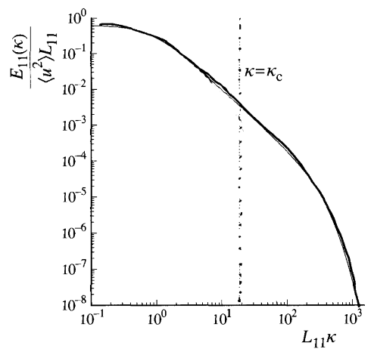

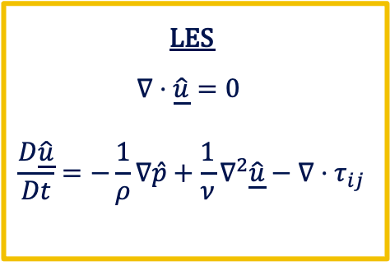

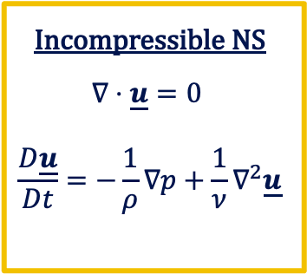
Large-Eddy Simulation
LES applies a linear operator (i.e. Filter) to the governing equations.
Incompressible NS
$∇⋅\underline{u}=0$
$$\frac{D\underline{u}}{Dt}=−\frac{1}{ρ}∇p+\frac{1}{ν}∇^{2}\underline{u}$$
LES
$∇⋅\underline{\hat{u}}=0$
$$\frac{D\underline{\hat{u}}}{Dt}=−\frac{1}{ρ}∇\hat{p}+\frac{1}{ν}∇^{2}\underline{\hat{u}}−∇⋅τ_{ij}$$
Sharp Spectral
Filter
$$ℱ$$
Resolved
SGS
Resolved
SGS
Pope Cambridge Press, 2004
Notes:
In the large eddy simulation, a linear operator is applied to the governing equations to only simulate the filtered scales while modeling the residual scales.
A common filter to use is the sharp spectral cutoff filter. As shown in this one dimensional energy spectra, the sharp spectral cutoff filter creates a distinction between the resolved large scale structures and the modelled small scale structures (in this case, we call them the subgrid-scale terms). Essentially, we are modeling the small scale structure of turbulence.
When we apply the sharp spectral filter to the governing navier-stokes equations, we get the resolved scales which are simulated and then a Subgrid-scale which we must model

Slide 9
SGS model
Most SGS models are based on global transfer of energy dissipation (Standard & Dynamic Smagorinsky model)
→Does not work well for non-homogeneous (wall-bounded) flows
Energy Cascade
Objective: Create an SGS model purely based on the governing equations
Resolved
SGS

Slide 10
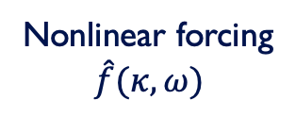
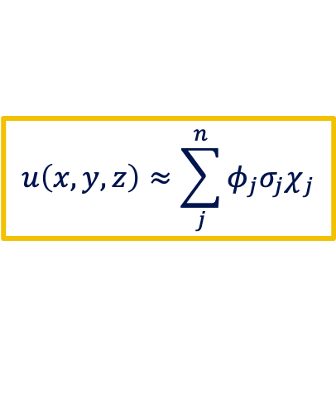
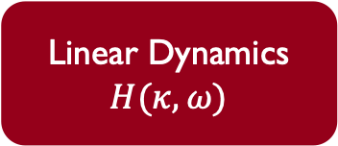
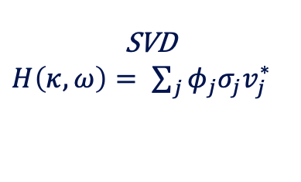
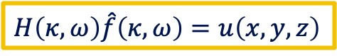
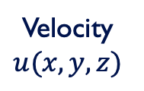
Reduced-order model of governing equations
Linearized dynamics in spectral space
Linear Dynamics
$$H(κ,ω)$$
Nonlinear forcing
$$\hat{f}(κ,ω)$$
Velocity
$$u(x,y,z)$$
$H\left(κ,ω\right)\hat{f}\left(κ,ω\right)=$ $u\left(x,y,z\right)$
Extract dominant structures from Linear Operator
SVD
$H\left(κ,ω\right)= \sum_{j}{φ_{j}σ_{j}v_{j}^{∗}}$
nth order approximation
$$u\left(x,y,z\right)≈\sum_{j}^{n}{φ_{j}σ_{j}χ_{j}}$$

Slide 11
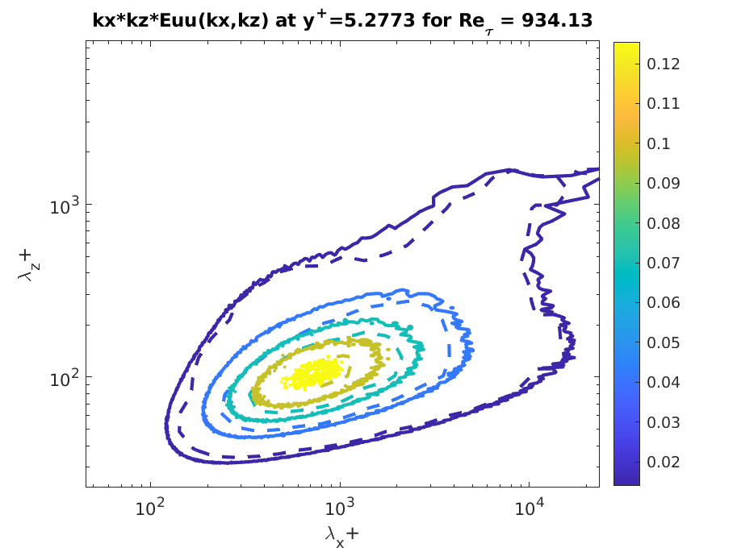
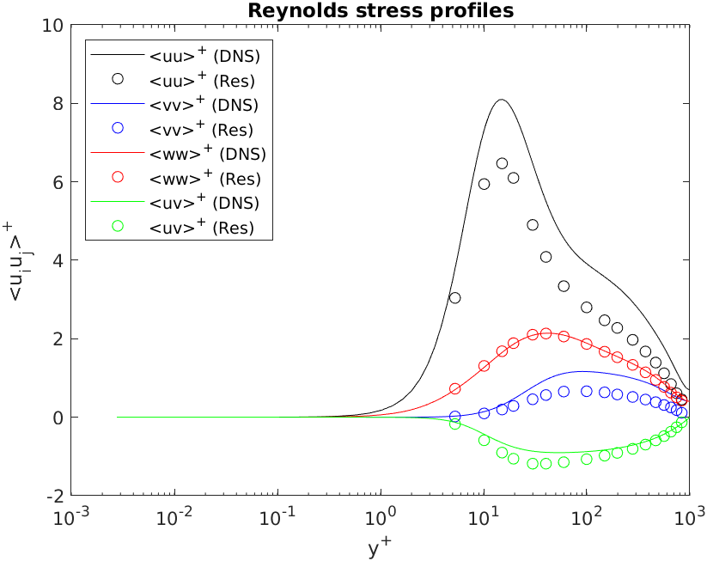

Computing weights $χ$
Solving weights by solving nonlinear convex optimization with Filtered Energy Spectra
Dotted (ROM)
Solid (DNS)

Slide 12

Why ?
My Goals
Work on projects with long lasting impact
Arup
Fosters a healthy learning environment
Invest in Arup
Arup University
Brings together different fields help build a sustainable future
Allows me to conduct work aligned with my principles
Conduct research directly applied to sustainable engineering
Understand concepts from first principles to learn concepts from different fields

Slide 13
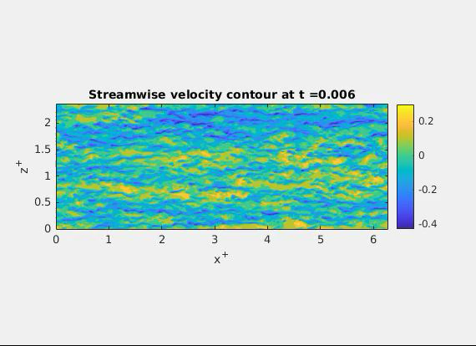
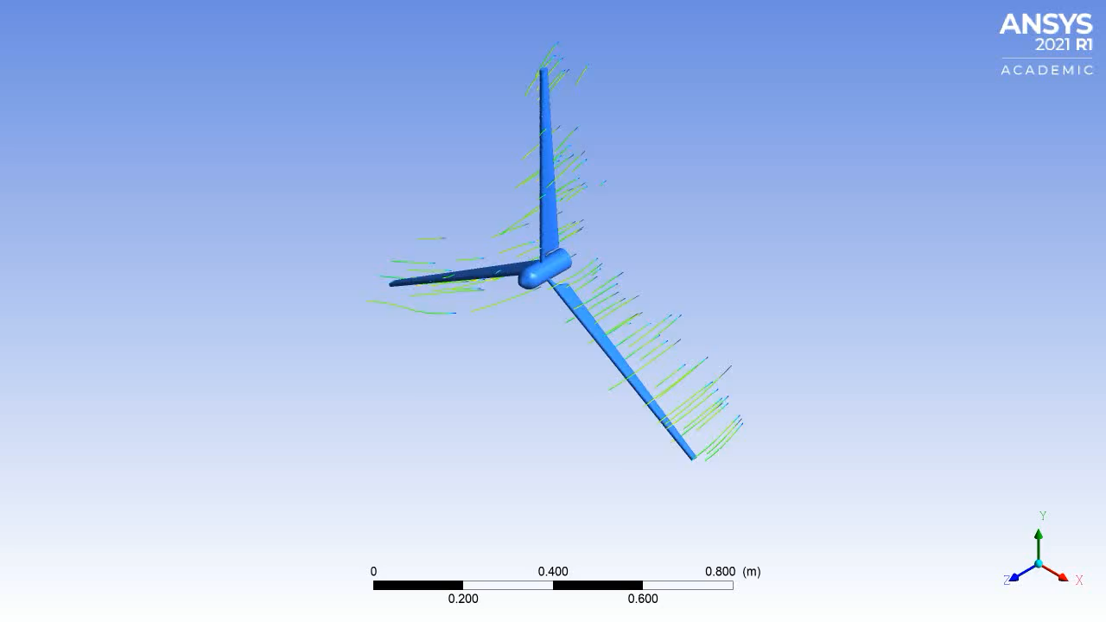
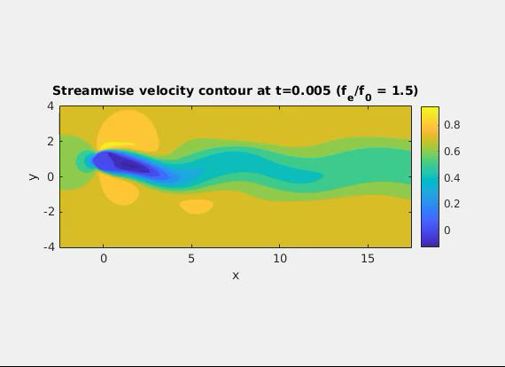
Thank you!
3D turbulent channel flow simulation
Reduced-order modeling of transversely oscillating cylinder
3D simulation of rotating dynamics of wind turbine

Slide 14
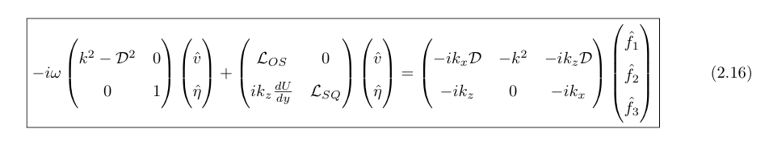
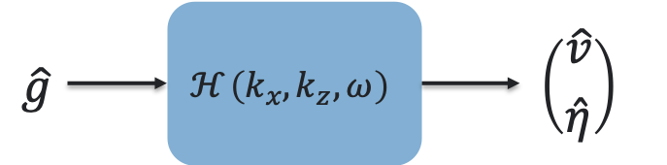
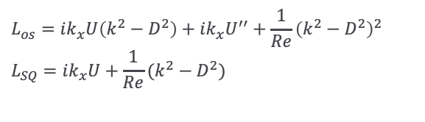
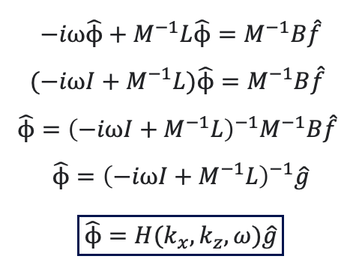
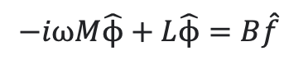
Compact form of the problem
$$L_{os}=ik_{x}U\left(k^{2}−D^{2}\right)+{ik_{x}U}^{′′}+\frac{1}{Re}{\left(k^{2}−D^{2}\right)}^{2}$$
$$L_{SQ}=ik_{x}U+\frac{1}{Re}(k^{2}−D^{2})$$
$$−iωM\hat{ϕ}+L\hat{ϕ}=B\hat{f}$$
$$−iω\hat{ϕ}+M^{−1}L\hat{ϕ}=M^{−1}B\hat{f}$$
$$(−iωI+M^{−1}L)\hat{ϕ}=M^{−1}B\hat{f}$$
$$\hat{ϕ}={{\left(−iωI+M^{−1}L\right)}^{−1}M}^{−1}B\hat{f}$$
$$\hat{ϕ}={\left(−iωI+M^{−1}L\right)}^{−1}\hat{g}$$
$$\boxed{\hat{ϕ}=H(k_{x},k_{z},ω)\hat{g}}$$
The resolvent operator is a linear mapping between the Fourier transformed “Forcing” field to the Fourier transformed ”velocity” field
“Transfer Functions”
“Input-output Analysis”

Slide 15
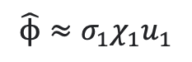
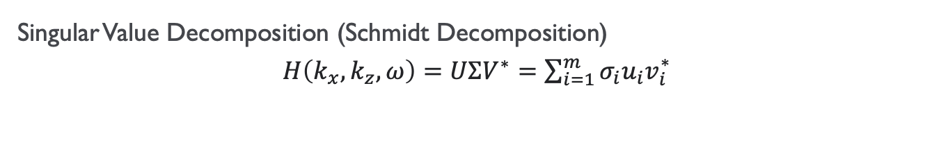
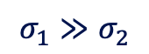
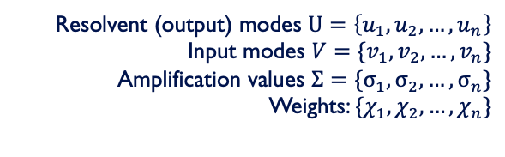
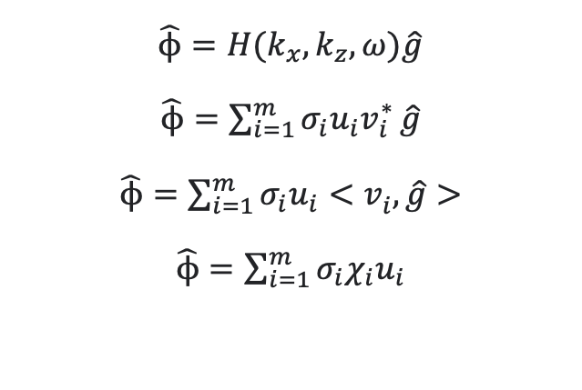
Singular Value Decomposition of the Resolvent Operator
Singular Value Decomposition (Schmidt Decomposition)
$H\left(k_{x},k_{z},ω\right)=UΣV^{∗}=\sum_{i=1}^{m}{σ_{i}u_{i}v_{i}^{∗}}$
$$\hat{ϕ}=H(k_{x},k_{z},ω)\hat{g}$$
$\hat{ϕ}=\sum_{i=1}^{m}{σ_{i}u_{i}v_{i}^{∗}}\hat{g}$
$\hat{ϕ}=\sum_{i=1}^{m}{σ_{i}u_{i}{<v}_{i}^{ },}\hat{g}>$
$\hat{ϕ}=\sum_{i=1}^{m}{σ_{i}{χ_{i}u}_{i}}$
Resolvent (output) modes $U=\left\{u_{1},u_{2},…,u_{n}\right\}$
Input modes $V=\{v_{1},v_{2},…,v_{n}\}$
Amplification values $Σ=\{σ_{1},σ_{2},…,σ_{n}\}$
Weights: $\{χ_{1},χ_{2},…,χ_{n}\}$
$$σ_{1}≫σ_{2}$$
$$\hat{ϕ}≈σ_{1}χ_{1}u_{1}$$
First-rank approximation

Slide 16
Optimization problem
Recall optimization problem: Compute weights that minimize error between DNS spectra and Resolvent Spectra
$$minimize \sum{\frac{{\left|\left|E_{r,DNS}−χ_{i}∗E_{r,resolvent}\right|\right|}^{2}}{{\left|\left|E_{r,DNS}\right|\right|}^{2}}}$$
$$=\frac{{\left|\left|D_{uu}−χ_{1}^{2}∗R_{uu}\right|\right|}^{2}}{{\left|\left|D_{uu}\right|\right|}^{2}}+\frac{{\left|\left|D_{uv}−χ_{1}^{ }∗χ_{2}∗R_{uv}\right|\right|}^{2}}{{\left|\left|D_{uv}\right|\right|}^{2}}+\frac{{\left|\left|D_{vv}−χ_{2}^{2}∗R_{vv}\right|\right|}^{2}}{{\left|\left|D_{vv}\right|\right|}^{2}}=Error$$
$D=E_{r,DNS}$ $R=E_{r,resolvent}$ $χ_{1}$ = weight for u’ $χ_{2}$ = weight for v’

